Slide 1
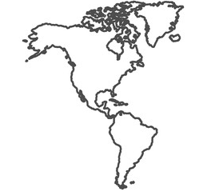
E
1
3
4
A
G
D
B
C
2
H
5
F

Slide 2
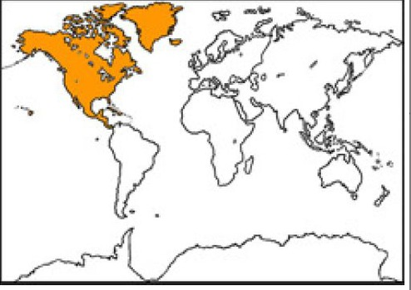
North America

Slide 3
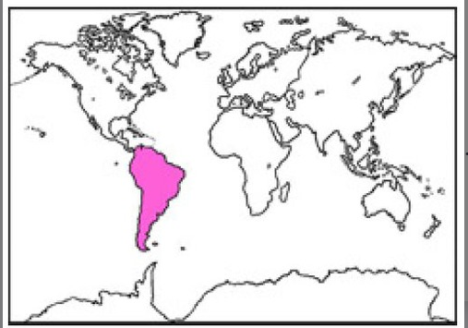
South America

Slide 4
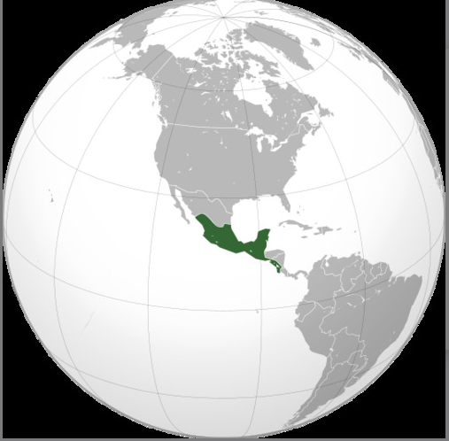
Central America

Slide 5
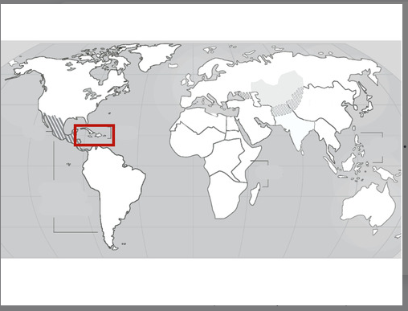
Caribbean

Slide 6
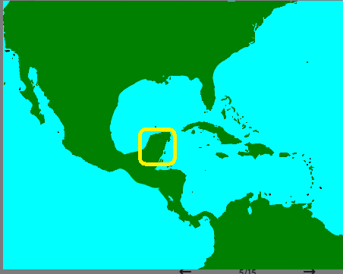
Yucatan peninsula

Slide 7
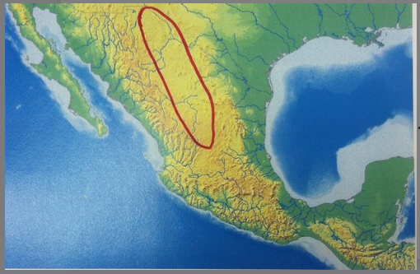
Central Mexican Plateau

Slide 8
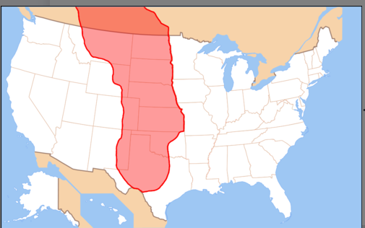
Great Plains

Slide 9

Gulf of Mexico

Slide 10
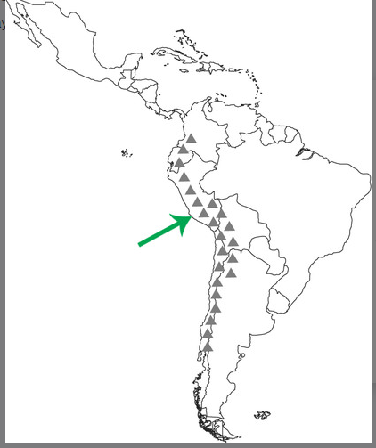
Andes Mountains

Slide 11
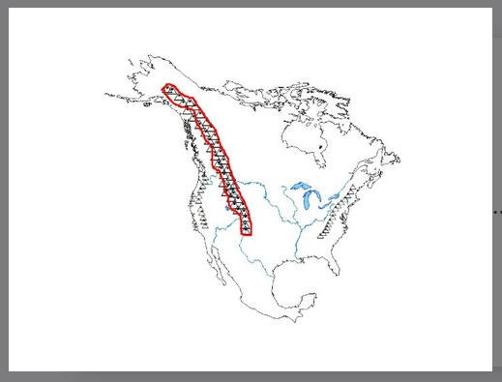
Rocky Mountains

Slide 12
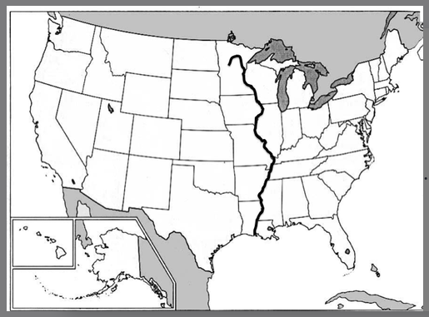
Mississippi River

Slide 13

Amazon River

Slide 14
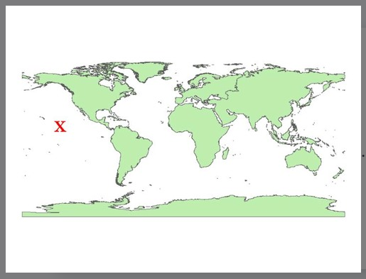
Pacific Ocean

Slide 15

Atlantic Ocean

Slide 16
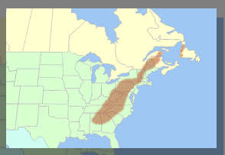
Appalachian Mountains

